Slide 1
Aspect Based Sentiment Analysis with Gated Convolutional Networks
Ananya Mantravadi
CS19B1004
Faculty:
Prof. C Krishna Mohan
Dept. of CSE, IIT Hyderabad
Authors:
Wei Xue and Tao Li
Teaching Assistant:
Prudviraj Jeripothula
PhD Research Scholar
Publisher:
Association for Computational Linguistics

Slide 2
Outline
Motivation
Problem Statement
Related Work
Proposed Approach
Datasets
Results
Conclusion
Future Directions
References

Slide 3
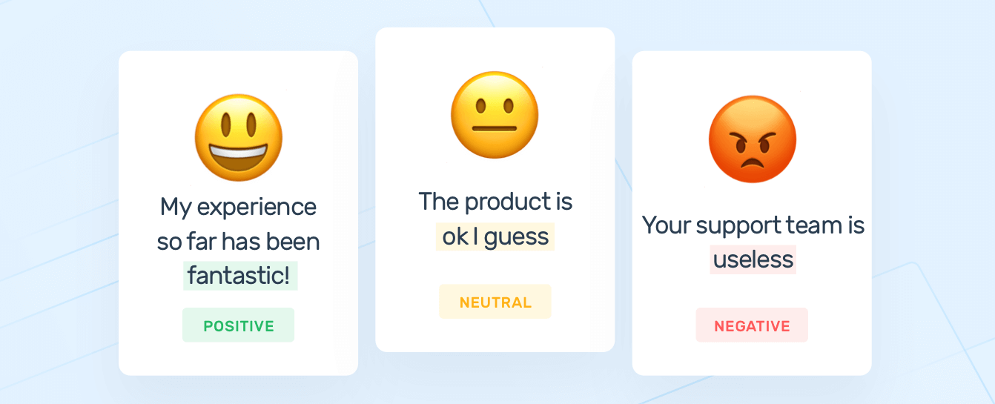
Motivation - Sentiment Analysis
Notes:
Sentiment analysis, also known as opinion mining, is a field within natural language processing (NLP). It aims to automatically identify the sentiment of a piece of text into in categories like positive, neutral and negative.

Slide 4



Applications
Business Insights
News Sources
Question Answering
Notes:
Sentiment analysis is an important task, both academically and commercially.
Sentiment analysis has many applications in businesses and organizations. It can be used to give valuable insights into how people feel about your product brand or service. It can also be used to identify potential negative threads that are emerging online. So that you can deal with it more quickly.
In news sources, sentiment analysis can be used to detect if there is any bias expressed by the author.
Sentiment Analysis can also be applied in Question-Answering, to identify opinion-oriented questions.

Slide 5
Aspect Based Sentiment Analysis
“Battery life is good, but the screen size is too small.”
Aspect: Battery life, Polarity: Positive
Aspect: Screen size, Polarity: Negative
Notes:
Traditional sentiment analysis focuses on classifying the overall sentiment expressed in a text without specifying what the sentiment is about. This may not be enough if the text is expressing different sentiments towards different aspects. Identifying sentiments associated to specific aspects in a text is a more complex task, and this is known as aspect-based sentiment analysis. Instead of predicting the overall sentiment polarity, aspect based sentiment analysis is proposed to better understand reviews than traditional sentiment analysis. Goal is to identify the aspects of given target entities and the sentiment expressed for each aspect.
“Battery life is good, but the screen size is too small.”
Aspect: Battery life, Polarity: Positive
Aspect: Screen size, Polarity: Negative

Slide 6
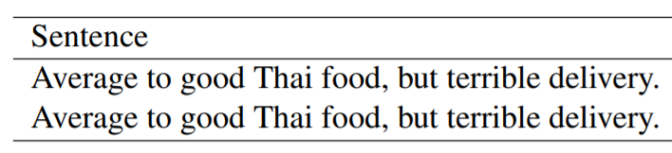
Problem Statement
Two subtasks:
Aspect-Category Sentiment Analysis (ACSA)
Aspect-Term Sentiment Analysis (ATSA)
ATSA: Food, Delivery
ACSA: Service
Notes:
A number of models have been developed for ABSA. But there are two different subtasks, aspect-category sentiment analysis, (ACSA) and aspect-term sentiment analysis, (ATSA).
The goal of ACSA is to predict the sentiment polarity with regard to a predefined category.
On the other hand, the goal of ATSA is to identify the sentiment polarity concerning the target entities that appear in the text. These targets could be a single word or a multi-word phrase.
For example, consider the sentence “Average to good Thai food, but terrible delivery.”
ATSA would ask the sentiment polarity towards the entity Thai food which has the aspects food and delivery. Accordingly, these aspects are labelled positive and negative.
But, ACSA would ask the sentiment polarity toward the aspect service, even though the word service does not appear in the sentence.

Slide 7
Related Work
Earlier research works: labor-intensive handcraft features
Neural network-based approaches
Target-dependent: LSTM & attention mechanisms
NRC-Canada / SVM
TD-LSTM
ATAE-LSTM
IAN
RAM
CNN
GCN
Notes:
Earlier research works are mainly focused on traditional machine learning approaches that involve handcrafted features. These approaches models achieve comparable performance, but their performance mainly depends on the quality of the labor-intensive handcraft features. Later, researchers used neural network-based approach for aspect level sentiment classification. They have obtained good performance on sentiment analysis, but such neural network-based approaches do not use targets. They only use contexts for sentiment classification. It was shown that 40% errors are caused by not including targets in the sentiment classification. Realizing this, target-dependent LSTM and attention-based models were built. These approaches using LSTMs and attention mechanisms are usually complex and need more training time.
Here are some related works listed
We have an SVM trained with extensive feature engineering. The sentiment lexicons improve the performance significantly, but it requires large scale labeled data
TD-LSTM uses two LSTM networks to model the preceding and following contexts of the target to generate target-dependent representation for sentiment prediction
ATAE-LSTM is an attention-based LSTM. It appends the given aspect embedding with each word embedding as the input of LSTM, and has an attention layer above the LSTM layer
IAN is Interactive Attention Network and RAM is a Recurrent Attention network. Both are based on LSTM and attention mechanisms
CNN which provides a very strong baseline for sentiment classification
GCN (gated convolutional neural network) - which does not have the aspect embedding as an additional input

Slide 8
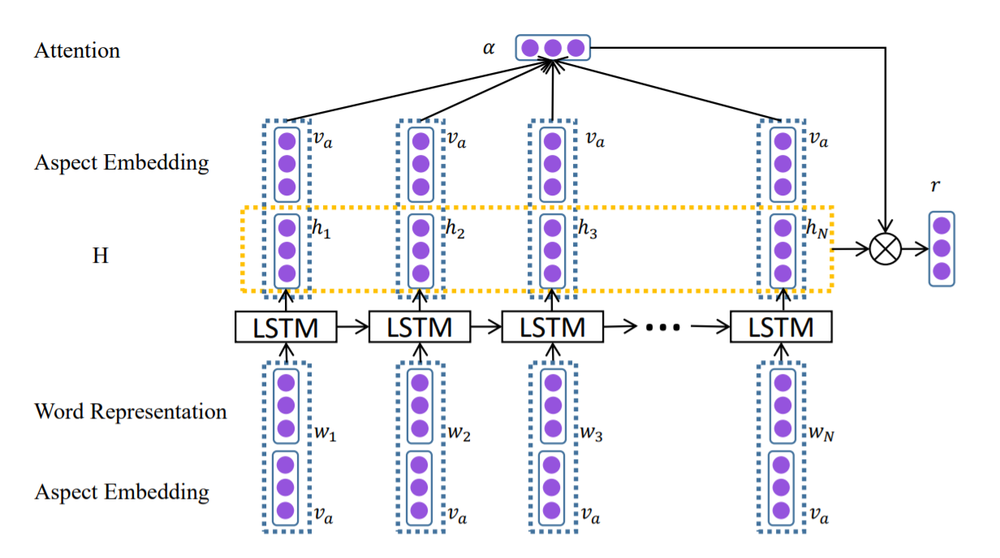
Attention-based LSTM (ATAE-LSTM)
Architecture & Limitations
Notes:
We look at one model that uses LSTM and attention mechanism - ATAE-LSTM
The aspect embeddings va have been take as input along with the word embeddings.
{w1, w2, . . . , wN } represent the word vector in a sentence whose length is N.
{h1, h2, . . . , hN } is the hidden vector.
The attention mechanism will produce an attention weight vector α and a weighted hidden representation r.
There is increased training time due to these time-dependent layers.
And also, for ABSA, it is important to separate aspect information and sentiment information from the extracted information of sentences.
The context vectors generated by LSTM are trying to convey both two kinds of information at the same time. The attention scores generated are for the entire context vector. This is another limitation.

Slide 9
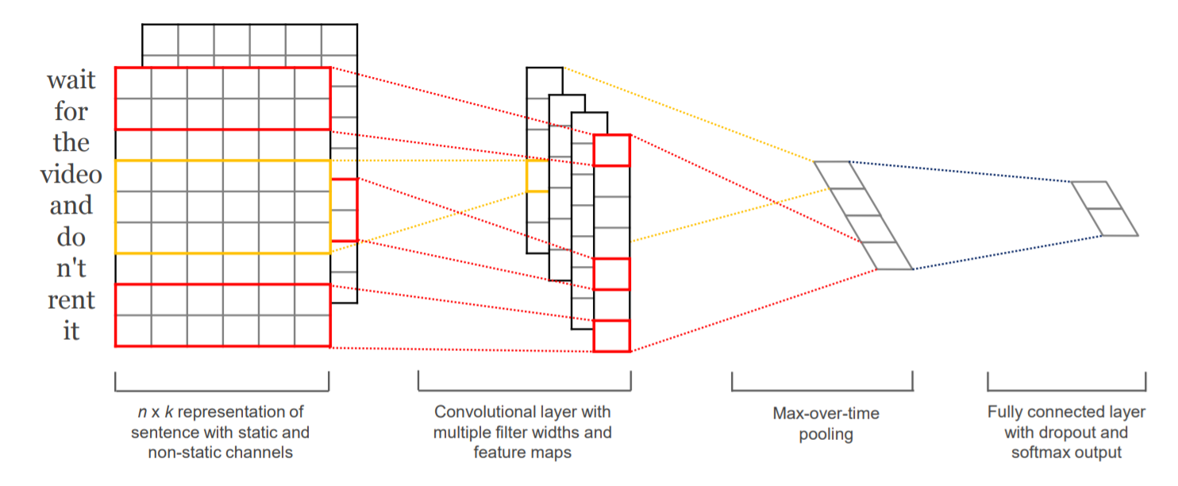
CNN - Architecture & Limitations
Notes:
Convolutional neural networks which were originally invented for computer vision have been shown to be effective for NLP. It uses multiple convolving filters to obtain multiple features.
CNN has been used for sentence-level classification which allows for parallelization and less training time. The drawback of this architecture is that it cannot directly capture aspect-specific sentiment information.

Slide 10
Proposed Approach
CNN Model with Gating Mechanism
Gated Tanh-ReLU selectively outputs sentiment features according to a given aspect or entity.
Simpler than existing models (compared to models with attention)
Can be trained in parallel - not time dependent unlike LSTM models
Notes:
This paper proposes a simple, fast and effective neural network for ACSA and ATSA based on convolutions and gating mechanisms.
Gated Tanh-ReLU selectively outputs sentiment features according to a given aspect or entity.
The computations of this model could be easily parallelized during training, because convolutional layers do not have time dependency as in LSTM layers. Gating units also work independently.
This model requires much less training time than LSTM based networks, and provides better accuracy.

Slide 11
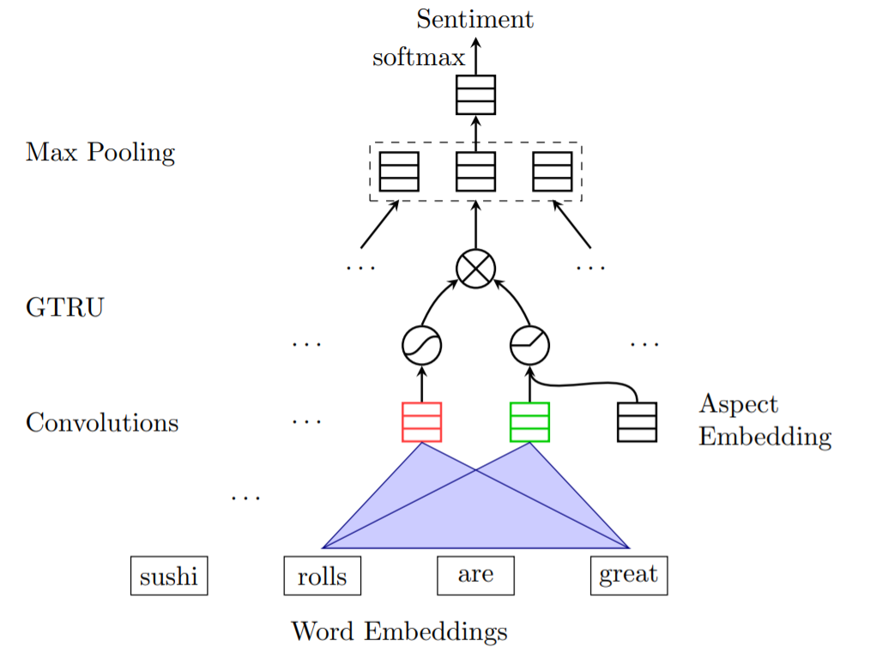


Gated Convolutional Network with Aspect Embedding (GCAE) for ACSA
Embedding Layer
Notes:
Here is the proposed approach - Gated Convolutional Network with Aspect Embedding for ACSA task
The embedding layer takes the input words and outputs the corresponding embedding vectors. D is the dimension size of the embedding vectors and V is the size of the word vocabulary. The embedding layer is usually initialized with pre-trained embeddings such as GloVe, which is Global Vectors for Word Representation. Then they are fine-tuned during the training stage.

Slide 12

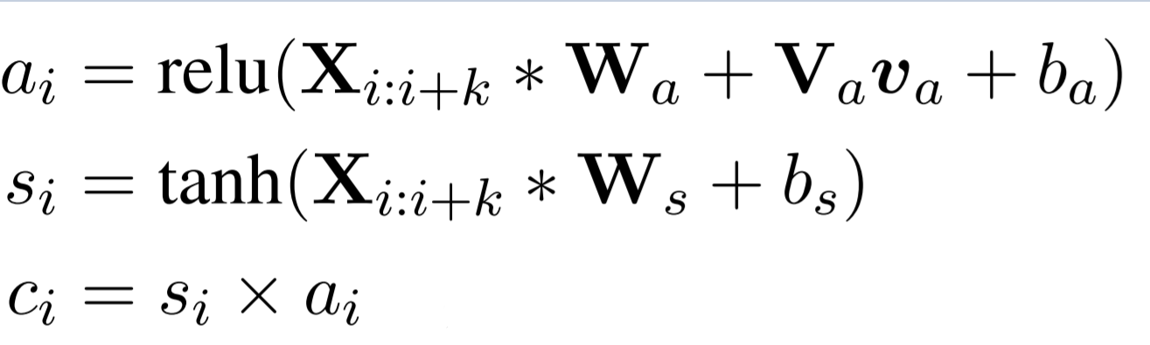
Gated Convolutional Network with Aspect Embedding (GCAE) for ACSA
2. Convolutions & Gated Tanh-ReLU Units (GTRU)
Notes:
The model has two separate convolutional layers on top of the embedding layer, whose outputs are combined by novel gating units.
The one-dimension convolutional layer convolves the inputs with multiple convolutional kernels of different widths. Each convolutional filter computes n-gram features at different granularities. Gated Tanh-ReLU Units or (GTRU) with aspect embedding are connected to two convolutional neurons.
Each feature ci is computed by multiplying si and ai element wise for the max pooling layer. si and ai are convolutional features responsible for generating sentiment features and aspect features respectively. As u can see, ai receives additional aspect information va with ReLU activation function.
va is the embedding vector of the given aspect category in ACSA or computed by another CNN over aspect terms in ATSA.
(In ABSA, it is common for aspects with different sentiments to appear in a single sentence. With ReLU, there is no limit on positive values, but limits on negative values. Therefore, it can be called the similarity between the given aspect information and aspect features. If 0, sentiment features will be blocked at the gate, otherwise they will be amplified.)

Slide 13
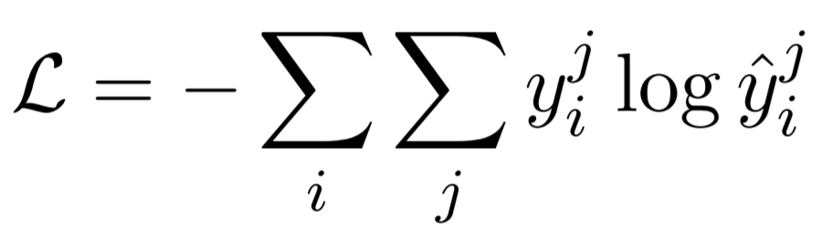


Gated Convolutional Network with Aspect Embedding (GCAE) for ACSA
3. Max-over-time pooling layer
4. Softmax
5. Training - Minimize cross-entropy loss
= ground-truth
= predicted value
Notes:
For each convolutional filter, the max-over-time pooling layer takes the maximal value among the generated convolutional features.
Finally, softmax function predicts the sentiment polarity yˆ. The model is trained by minimizing the cross-entropy loss between the ground-truth y and the predicted value yˆ for all data samples.

Slide 14
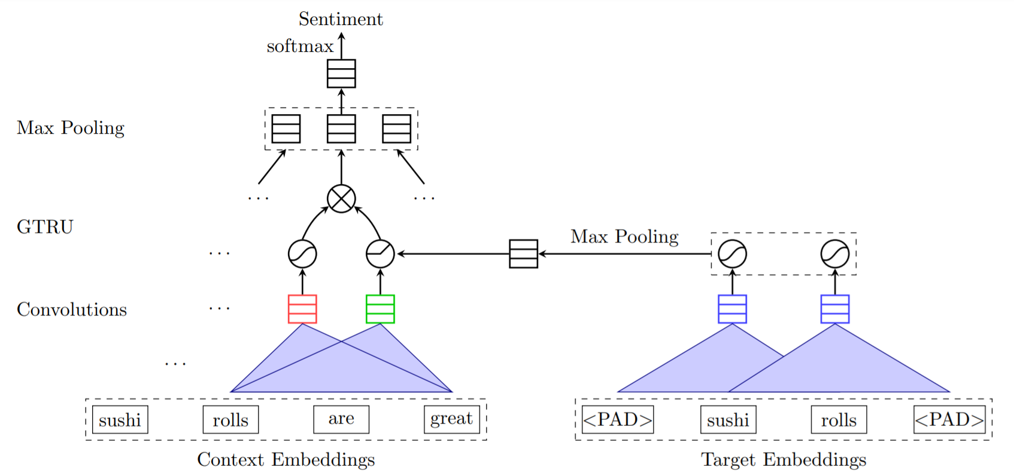
GCAE on ATSA
Notes:
ATSA task is defined to predict the sentiment polarity of the aspect terms in a sentence. We simply extend GCAE by adding a small convolutional layer on aspect terms.
In ACSA, the aspect information is from one aspect word; while in ATSA, that information is provided by a small CNN on aspect terms. The additional CNN extracts the important features from multiple words. This is done while retaining the ability of parallel computing.

Slide 15
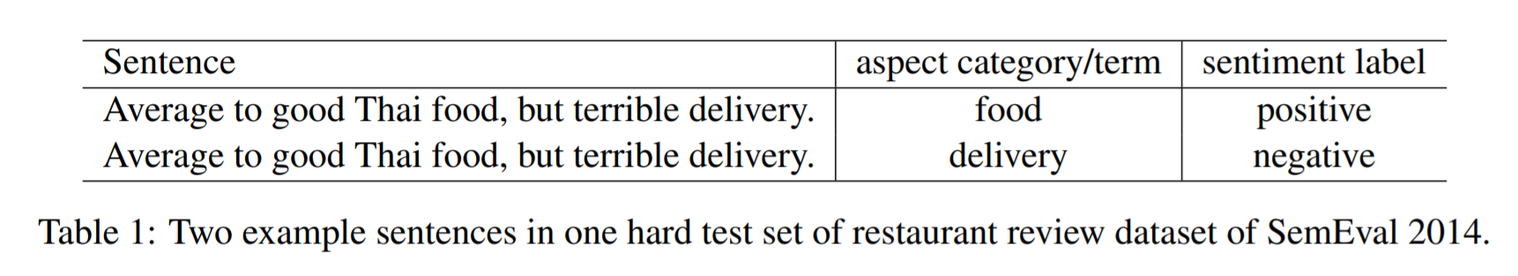
Datasets
SemEval Workshops - customer reviews: Restaurant & Laptop
Hard Datasets: Sentences having multiple aspect labels associated with multiple sentiments
Notes:
The datasets used in this model are public datasets from SemEval Workshops which consist of customer reviews about restaurant and laptops. In data which consists of reviews, it is more common for sentences to have different sentiment labels for different aspects or targets than in standard sentiment classification. This sentence shows the reviewer’s different attitude towards two aspects: food and delivery. Therefore, to assess how the models perform on review sentences more accurately, datasets were made up of sentences having different sentiments on different aspects/targets. Here we see two identical sentences but with different sentiment labels. Both are included in the dataset. Similarly, If a sentence has 4 aspect targets, this sentence would have 4 copies in the data set with respective sentiment labels.
The hard datasets are only made up of sentences that have multiple aspect labels associated with multiple sentiments.
(The test set is designed to measure whether a model can detect multiple different sentiment polarities in one sentence toward different entities. Without such sentences, a classifier for overall sentiment classification will be enough.)

Slide 16
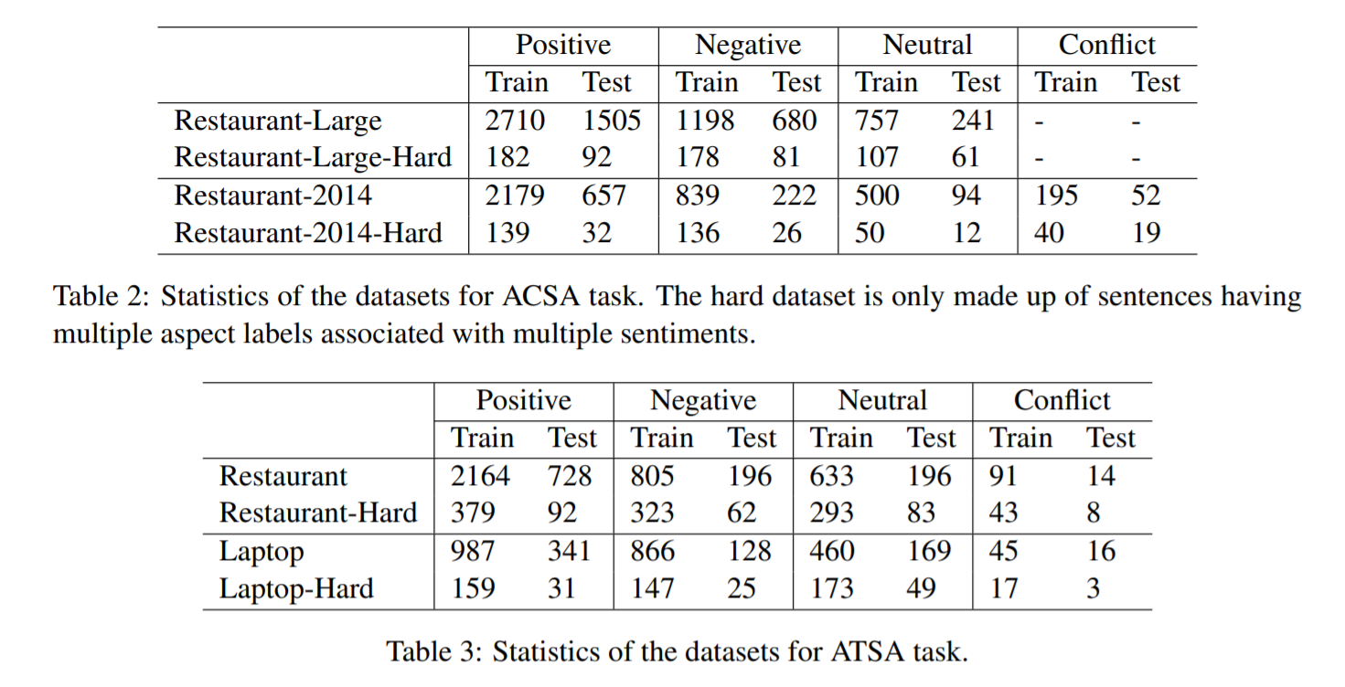
Datasets - ACSA Task
Aspects: food, price, service, ambience, and misc;
Sentiment polarities: positive, negative, neutral, and conflict.
Sentence label p: No. of positive labels - No. of negative labels Positive if p>0, Negative if p<0, Neutral if p=0
Notes:
For ACSA task the datasets had predefined Aspect categories - food, price, service, ambience, and misc;
Sentiment polarities: positive, negative, neutral, and conflict.
For each sentence, let p denote the number of positive labels minus the number of negative labels. We assign a sentence a positive label if p > 0, a negative label if p < 0, or a neutral label if p = 0.
A larger dataset called “Restaurant-Large” was created by merging restaurant reviews from 2014 to 2016.
In the 2015 and 2016 datasets, there could be multiple pairs of “aspect terms” and “aspect category” in one sentence.
(Conflict labels are replaced with neutral labels in the 2014 dataset)
(Here conflict label applies when both positive and negative sentiment is expressed about an aspect term (e.g., “Certainly not the best sushi in New York, however, it is always fresh”).)

Slide 17
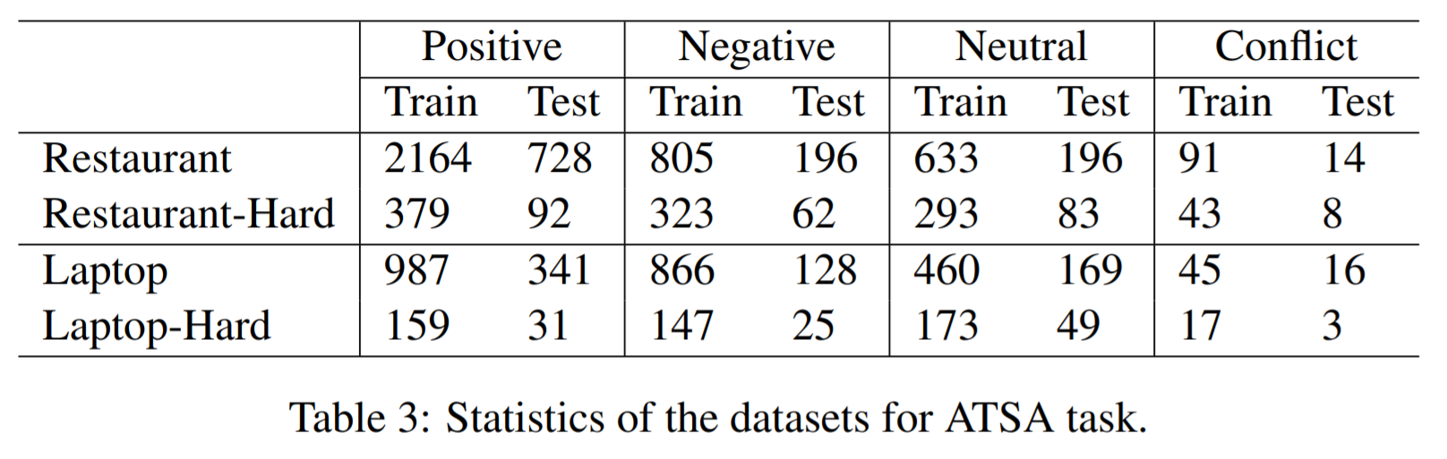
Datasets - ATSA Task
Duplicate each sentence n_{a} times
Notes:
For ATSA task, we use restaurant reviews and laptop reviews. On each dataset, each sentence was duplicated na times, which is equal to the number of associated aspect categories (ACSA) or aspect terms (ATSA).

Slide 18


Implementation Details
300-dimension GloVe vectors pre-trained on unlabeled data of 840 billion tokens
Random initialization - uniform distribution
Adagrad
Batch size: 32 instances
Learning Rate:
Maximal epochs: 30
5-fold cross validation
Notes:
In the experiments, word embedding vectors are initialized with 300-dimension GloVe vectors which are pre-trained on unlabeled data of 840 billion tokens.
Words out of the vocabulary of GloVe are randomly initialized with a uniform distribution U(−0.25, 0.25).
Adagrad optimizer was used, with a batch size of 32 instances, default learning rate of 10 power -2, and 30 epochs. They only fine tuned early stopping with 5-fold cross validation on training datasets.

Slide 19
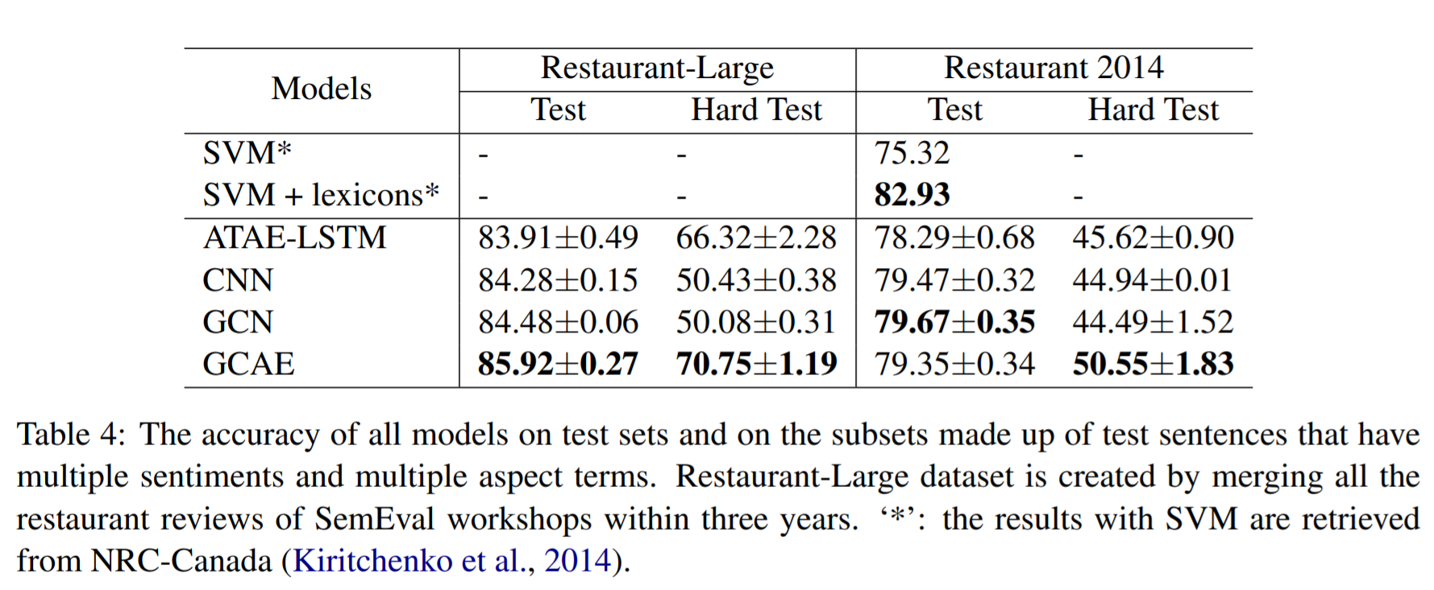
Results - ACSA
Notes:
These are the results for ACSA task after repeating every experiment five times. The mean and standard deviation is reported in the table.
LSTM based model ATAE-LSTM has the worst performance of all neural networks. Our model uses gating mechanism and does not generate a single context vector but two vectors for aspect and sentiment features respectively.
If we compare the performance of CNN on the hard test datasets, it is easy to see that GCAE is able to differentiate the sentiments of multiple entities.
The performance of SVM depends on the availability of the features it can use. Without the large amount of sentiment lexicons, SVM perform worse than neural methods. With multiple sentiment lexicons, the performance is increased a lot.
The hard test datasets consist of duplicated sentences with different sentiments towards different aspects. Models like CNN and GCN which cannot use aspect information perform poorly as expected, but GCAE has higher accuracy than other neural network models. But, we can notice that GCN has higher score than GCAE on the original restaurant dataset. This shows that GCN performs better than GCAE when there is only one sentiment label in the given sentence, but not on the hard test dataset.

Slide 20
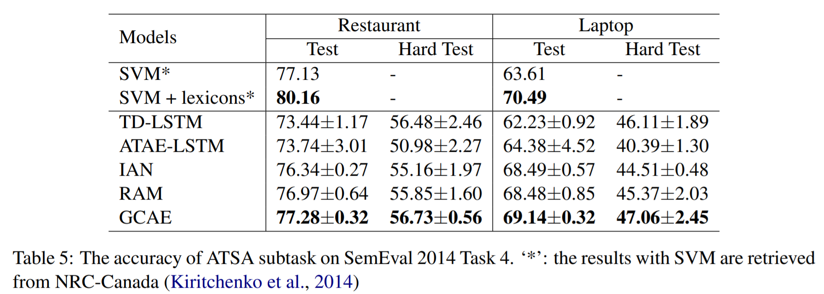
Results - ATSA
Notes:
Results for ATSA task-
IAN has better performance than TD-LSTM and ATAE-LSTM. RAM also achieves good accuracy, but it needs more training time as we will soon see. On the hard test dataset, GCAE has 1% higher accuracy than RAM on restaurant data and 1.7% higher on laptop data. GCAE uses the outputs of the small CNN over aspect terms tocontrol the flow of sentiment features through the ReLU gate. Because of the gating mechanisms and the convolutional layer over aspect terms, GCAE outperforms other neural models and basic SVM. Again, large scale sentiment lexicons bring significant improvement to SVM.

Slide 21

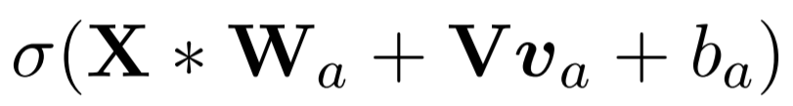
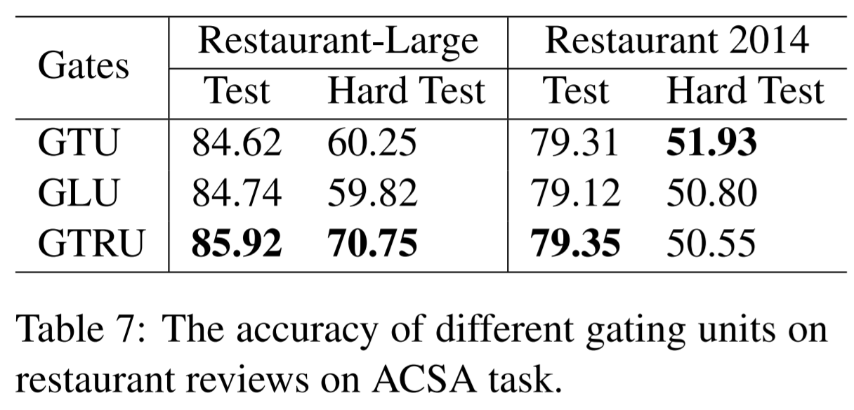
Gating Mechanisms
Gated Tanh Units (GTU):
Gated Linear Units (GLU):
Notes:
The gating mechanism is playing an important role in this network for both ACSA and ATSA tasks. It selectively extracts target-specific sentiment information for a given target.
if we take the same example from earlier -
“Battery life is good, but the screen size is too small.”
for the target ‘‘Battery life’’ gating mechanism ignores the negative sentiment of target ‘‘screen size’’ from the second clause and only considers the positive sentiment from the first clause
Here, we are comparing GTU and GLU which are two other effective gating mechanisms. We are now using them for text classification. GTU uses sigmoid gates, and faces the vanishing gradient problem. GLU was introduced to overcome this problem.
Results show that all of three gating units achieve relatively high accuracy on restaurant datasets. GTRU outperforms the other gates. It has a convolutional layer generating aspect features via ReLU activation function. This controls the magnitude of the sentiment signals according to the given aspect information. The sigmoid function in GTU and GLU has the upper bound of +1, due to which it might not be able to extract sentiment features effectively.

Slide 22
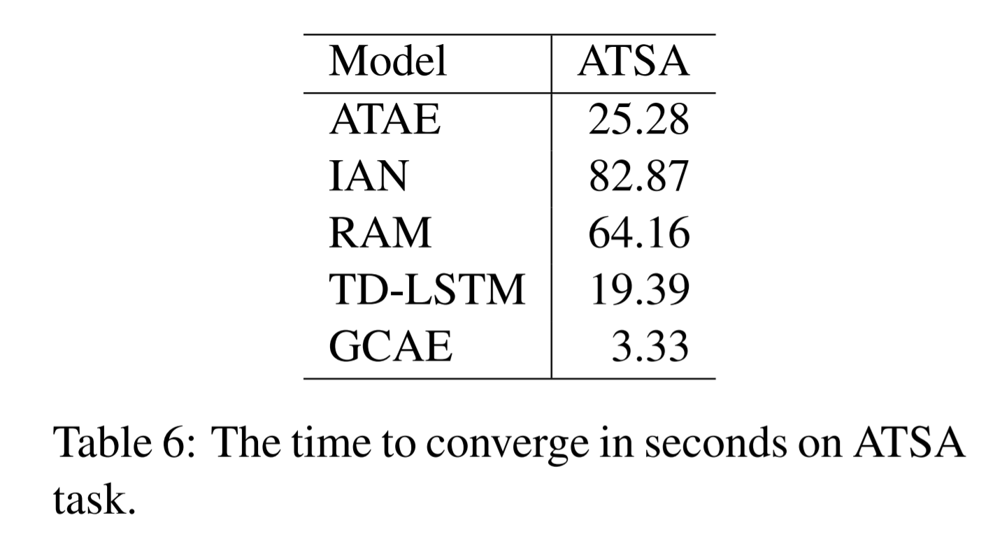
Training Time
Training time of all models until convergence on a validation set on a desktop machine with a 1080 Ti GPU
Notes:
The training time of all models until convergence.
LSTM based models take more training time than convolutional models. Because of multiple attention layers in IAN and RAM, they need even more time to finish the training. GCAE is much faster than other neural models. Convolutional operation and GTRU do not have time dependency like in LSTM and attention mechanisms. Therefore, hardware and libraries can be used to make the computing process parallelized.

Slide 23
Conclusion
An efficient CNN with gating mechanisms for ACSA and ATSA tasks.
GTRU controls the sentiment flow according to the given aspect information
Performance improvement compared with other neural models by extensive experiments on SemEval datasets.
Notes:
Concluding, We have seen an efficient convolutional neural network with gating mechanisms for ACSA and ATSA tasks.
GTRU can effectively control the sentiment flow according to the given aspect information, and two convolutional layers model the aspect and sentiment information separately.
Results have shown how there was a performance improvement compared with other neural models.

Slide 24
Future Directions
LSTM → CNN → CNN with Gating Mechanism
Transformers with Gating Mechanism for Sentiment Analysis
Notes:
motivation behind this proposed approach was to enable parallelization & limit training time.
We have seen LSTMs, then introduced CNN, and then added the gating mechansim.
But since nowadays the current state of art approach is to use transformers, we would like to explore transformers with gating mechanisms in future.
We will try to address the transformer architecture which employs better parallelization and better performance than CNN. In addition we would like to incorporate the gating mechanism in transformer and try to use it for sentiment analysis.

Slide 25
References
W. Xue and T. Li, ‘‘Aspect based sentiment analysis with gated convolutional networks,’’ in Proc. ACL, vol. 1, 2018, pp. 2514–2523.
Maria Pontiki, Dimitrios Galanis, John Pavlopoulos, Haris Papageorgiou, Ion Androutsopoulos, and Suresh Manandhar. 2014. Semeval-2014 task 4: Aspect based sentiment analysis. In SemEval@COLING, pages 27–35, Stroudsburg, PA, USA. Association for Computational Linguistics.
Dzmitry Bahdanau, Kyunghyun Cho, and Yoshua Bengio. 2014. Neural Machine Translation by Jointly Learning to Align and Translate. In ICLR, pages CoRR abs–1409.0473.
Yoon Kim. 2014. Convolutional Neural Networks for Sentence Classification. In EMNLP, pages 1746– 1751
Yequan Wang, Minlie Huang, Xiaoyan Zhu, and Li Zhao. 2016b. Attention-based LSTM for Aspect level Sentiment Classification. In EMNLP, pages 606–615.
Duyu Tang, Bing Qin, Xiaocheng Feng, and Ting Liu. 2016a. Effective LSTMs for Target-Dependent Sentiment Classification. In COLING, pages 3298– 3307
A. Kumar, V. T. Narapareddy, V. Aditya Srikanth, L. B. M. Neti and A. Malapati, "Aspect-Based Sentiment Classification Using Interactive Gated Convolutional Network," in IEEE Access, vol. 8, pp. 22445-22453, 2020

Slide 26
Thank You

